Slide 1
SJS 100: Introduction to Theories of Social Justice
Week 8: Indigenous Politics and Settler Colonialism
Instructor: Simon Carroll
MAC D116, March 6, 2023

Slide 2
What is Settler Colonialism?
Wolfe: “Whatever settlers may say—and they generally have a lot to say—the primary motive for elimination is not race (or religion, ethnicity, grade of civilization, etc.) but access to territory. Territoriality is settler colonialism’s specific, irreducible element.” (Wolfe, 2006, p. 388).
What is the ‘logic of elimination’?
Why is it that settler colonial societies sometimes symbolically promote indigenous culture? How does this fit in with the logic of elimination?
Settler colonialism vs. Occupational colonialism

Slide 3
Canada as a Settler Colonial Project
Five waves of settlement:
First Wave (1500s-1812):
French colonial settlers in New France (17th Century)
English settlers in the conquered territory of Canada post-1759 (Wolfe defeats Montcalme), eventually demanding a separate administration called Upper Canada (to become Ontario).
Large influx of ‘loyalist’ American-English post 1776.
Second Wave (1812-1851):
Mainly Irish, English and Scottish settlers, encouraged by the British Crown to offset the possible second invasion by the United States after the War of 1812.
Third Wave (1890-1920):
Mainly Continental Europeans, especially Southern and Eastern Europe.
Fourth Wave (1940-1960s):
Italians, Portuguese, Ukrainians
Fifth Wave (1970-present):
Mainly non-European countries, forming the rapid expansion of visible minorities as a proportion of the Canadian population.

Slide 4
Settler Colonialism in Canada cont.
Always a combination of Merchants, looking to make a profit on resource extraction, and landless laborers and farmers given the opportunity to flee various oppressive circumstances in Europe first, and then later other parts of the world.
The ideology of ‘productivism’ was a central theme for many of the pioneer settlers, and this forms part of the ideology of dismissal and rejection of Indigenous claims for justice and restitution.
Important to understand that although settler colonialism does leave a ‘legacy’ to its victims (based on previously inflicted trauma), it just as significantly, leaves a real material legacy of wealth and power to contemporary settler inheritors.

Slide 5
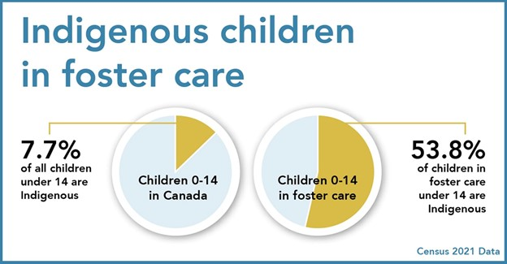
Indigenous children in care

